Slide 1
Bidirectional LSTM-CRF Models for Sequence Tagging
arXiv preprint arXiv
Huang, Zhiheng, Wei Xu, and Kai Yu Baidu research
단국대학교 Eduai 센터
발표자 : 김태경

Slide 2
LISt
Introduction
What’s machine learning
Method
Conclusion

Slide 3
Introduction
This paper systematically compared the performance of aforementioned models on NLP tagging data sets
The first to apply a bidirectional LSTM CRF (BI-LSTM-CRF) model
BI-LSTM-CRF model is robust and it has less dependence on word embedding as compared to previous observations

Slide 4
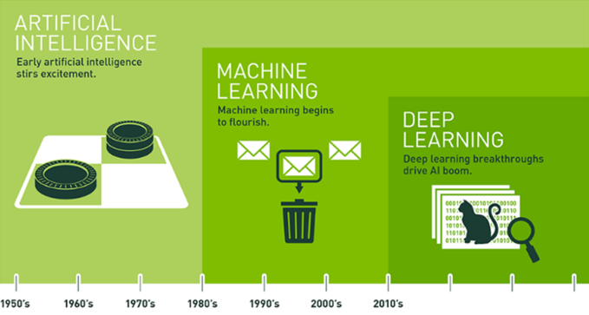
What’s machine learning
Artificial intelligence is intelligence exhibited by machines
Machine learning is computers the ability to learn without being explicitly programmed
Deep learning is part of a broader family of machine learning methods based on learning data representations, as opposed to task-specific algorithms

Slide 5
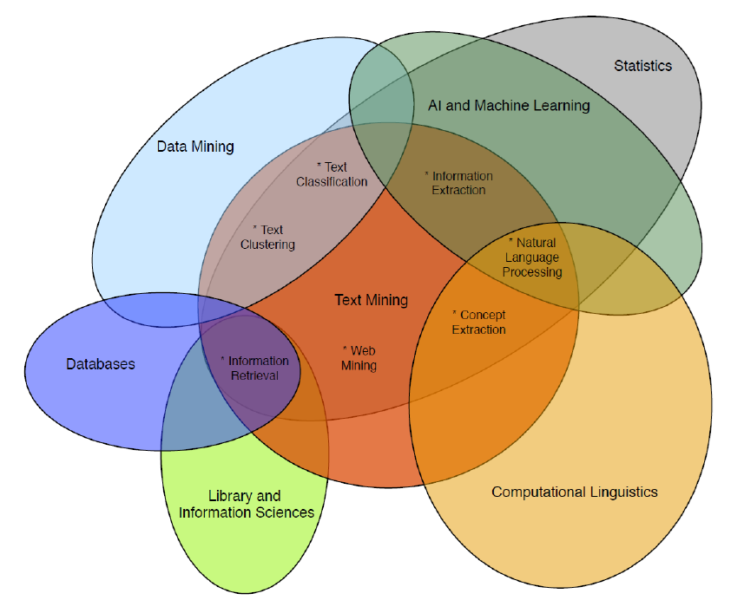
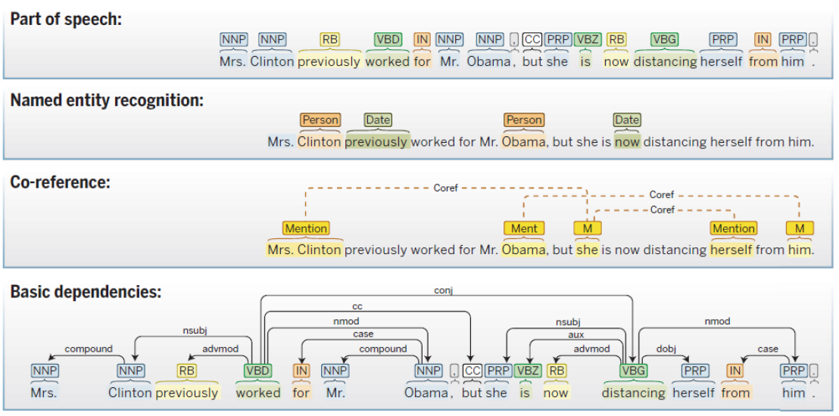
Classic NLP

Slide 6
Method(CNN)
Originally invented for computer vision (Lecun et al, 1989)
Pretty much all modern vision systems use CNNs
Figure 1. “Gradient-based learning applied to document recognition” LeCun et al. IEEE 1998

Slide 7
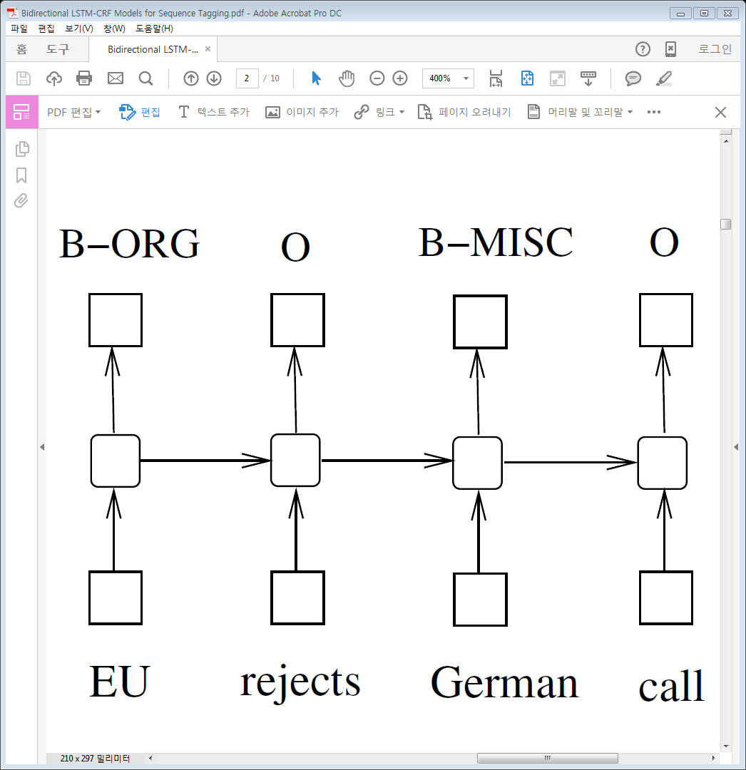
Method(RNN(Recurrent neural network))
A RNN maintains a memory based on history information
The model to predict the current output con-ditioned on long distance features
$$h(t)=f(U_{Χ}\left(t\right)+Wh(t−1))$$
Output layer $y$
$$y(t)=g(Vh(t))$$
Features at time $t$
Hidden layer $h$
Input layer $χ$

Slide 8
Method(LSTM(Long short-term memory))
LSTM are the same as RNNs
LSTM except that the hidden layer updates are replaced by purpose-built memory cells

Slide 9
Method(Bi-LSTM(bidirectional LSTM))
Use forward states & backward states
Using Back propagation through time(BPTT)

Slide 10
Method(CRF(conditional random fields)
Use of neighbortag information in predicting current tags
Focus on sentence level instead of individual positions
The inputs and outputs are directly connected

Slide 11
Method(LSTM-crf)
Combine a LSTM network and a CRF network to form a LSTM-CRF model
Use past input features via a LSTM layer and sentence level tag information via a CRF layer

Slide 12
Method(BI-LSTM-CRF)
Combine a bidirectional LSTM network and a CRF network to form a BI-LSTM-CRF network
Used in a LSTM-CRF model, a BI-LSTM-CRF model can use the future input feature

Slide 13
Conclusion
This paper systematically compared the performance of LSTM networks based models for sequence tagging
This paper model can produce state of the art (or close to) accuracy on POS, chunking and NER data sets
This proposed model is robust and it has less dependence on word embedding as compared to the observation

